Slide 1
Six Sassy
Sentences
(tips for adding variety to boring sentences)

Slide 2
Why use variety in your sentences?
Sentence variety is necessary for a number of reasons:
* Sentence variety makes your writing more interesting to read!
* Sentence variety adds style to your writing!
* Sentence variety will help develop your writing skills!

Slide 3
Six Sassy Sentence types:
1. Two-adjective beginnings
2. “-ing” at beginning or end
3. “-ly” beginnings
4. Informative interrupters (appositives)
5. Balanced sentences
6. Dependent clauses

Slide 4
1. Two-Adjective Beginnings:
Tall, handsome lifeguards flirt wildly with the pretty girls.
Rickety and dilapidated, the old schoolhouse didn’t stand a chance in an earthquake.

Slide 5
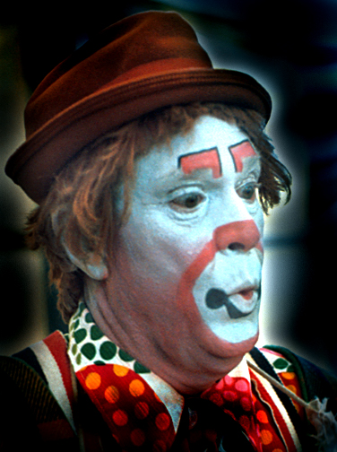
Now you try:

Slide 6
2. “-ing” at beginning
Running like the wind, Forrest Gump made national headline news.
Saving the best for last, Lisa finally ate her Reese’s peanut butter cup.

Slide 7
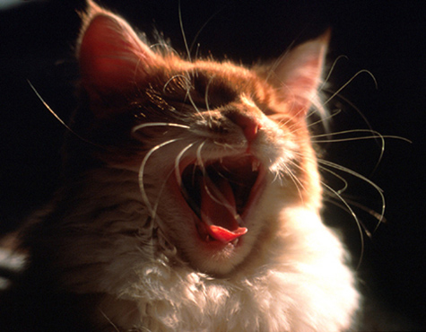
Now you try:

Slide 8
“-ing” at end
He trudged along the hot desert for days, wishing he had brought more water.
Sandy gave the homeless man all the money she had, hoping that her small act of kindness might bring him some comfort.

Slide 9
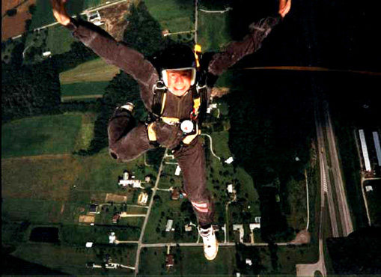
Now you try:

Slide 10
3. “-ly” at beginning
Cheerfully, she answered the phone for her mother.
Slowly opening the door, the servant tried not to wake his master.

Slide 11
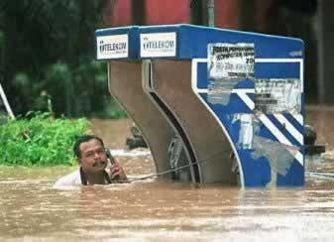
Now you try:

Slide 12
4. Informative Interrupters
The fish, a slimy mass of flesh, felt the alligator’s giant teeth sink into him as he struggled to swim away.
The child, face covered with chocolate doughnut, asked his mother if he could have some milk.

Slide 13
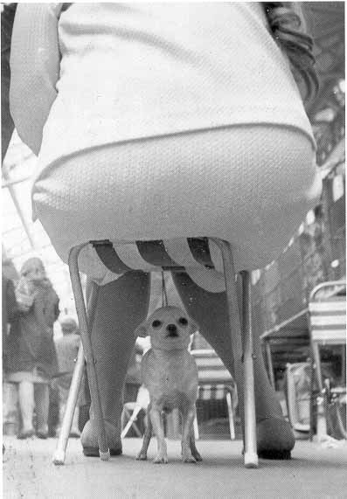
Now you try:

Slide 14
5. Balanced Sentences
He runs onto the baseball field, spins around second base, and looks back at the academy.
Choosing a Christmas tree, putting up Christmas lights, and baking Christmas cookies are all included in my December traditions.

Slide 15
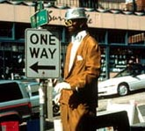
Now you try:

Slide 16
6. Dependent Clauses
Because it rained, the garden party was postponed.
Since the road construction is complete, Jim can make it home in only ten minutes.

Slide 17
Now you try:

